Slide 1
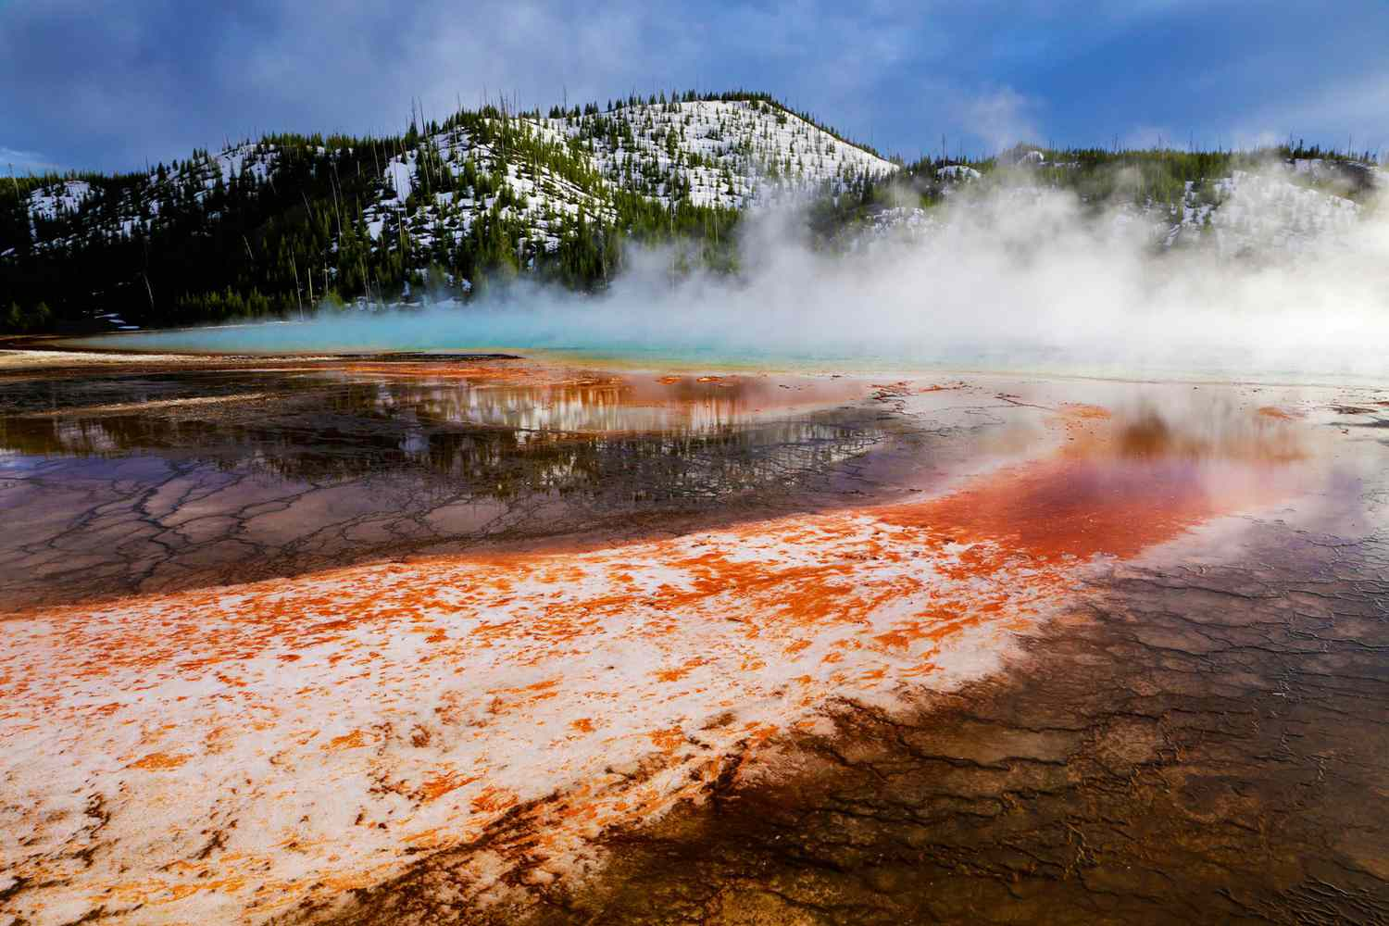





Where Are All of the Ammonia Oxidizers?: A Tale of Two Metals
Simon Fronmueller
Mentors/Advisors: Kate Weeks and Dr. Everett Shock
ASU School of Earth and Space Exploration
AZ Space Grant Symposium
April 19-20, 2024
Background image credit: AGU

Slide 2
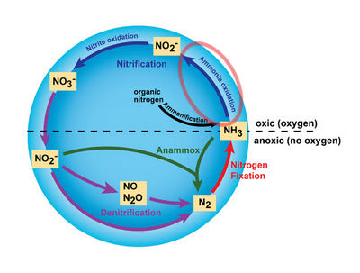

What are Ammonia Oxidizers?
Microbes (archaea and bacteria)
Oxidize ammonia for energy
Globally abundant
Critical to nitrogen cycle
Used in wastewater treatment
Understudied and hard to culture
Modified Image Source: Anne Bernhard (2010)

Slide 3
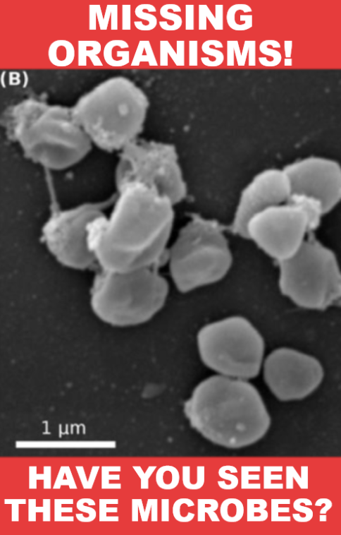
The Mystery
Nitrogen cycle critical to all life, including in hot springs, so would expect to find them in YNP springs
Conditions seem suitable for AOA (ammonia oxidizing archaea)
AOA seemingly absent
Geochemical cause unknown
Modified image source: Anne Daebeler, et al. (2018)

Slide 4
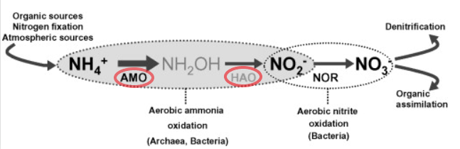
Hypothesis: Miserable Metalheads!
Ammonia oxidation needs enzymes
Copper and iron ions are cofactors
Cofactors are the “car keys” of an enzyme
Hot springs may not have enough
Copper / iron ions must be “bioavailable”
Modified image credit: Christa Schleper, et al. (2010)

Slide 5
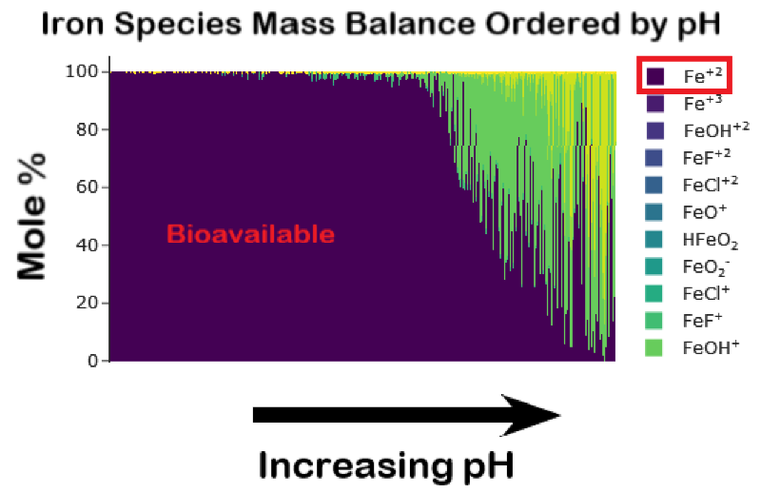
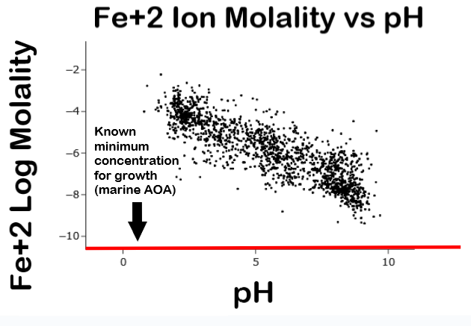
Bountiful Bioavailable Iron
Minimum concentration source: Roxana T. Shafiee, et al. (2019)

Slide 6
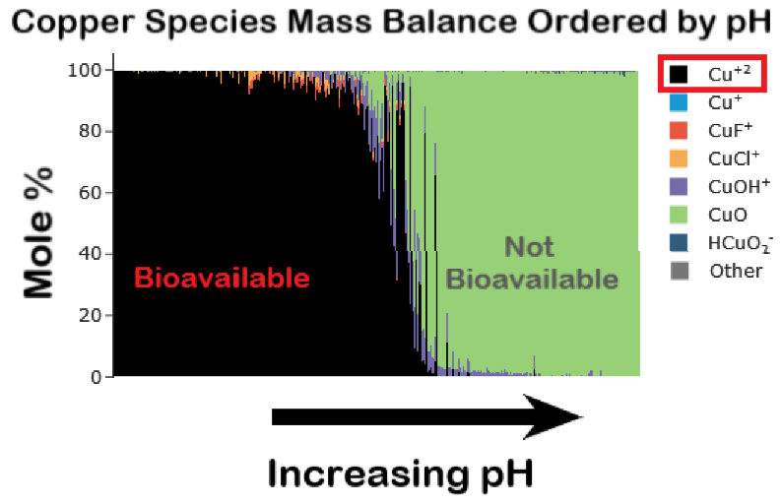
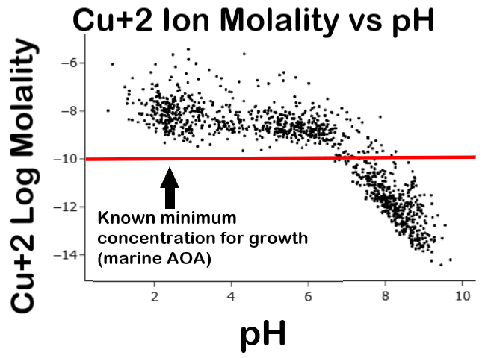
Sparse Bioavailable Copper
Minimum concentration source: Shady A. Amin, et al. (2013)

Slide 7
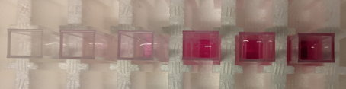
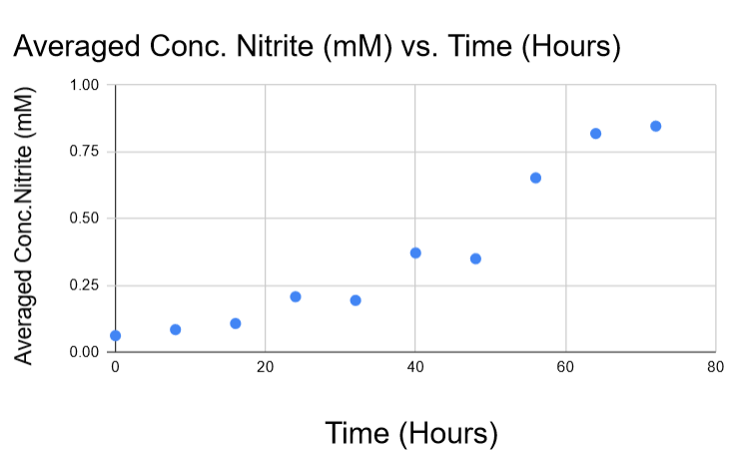
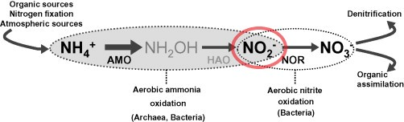
Lab Work: Nitrite Measurements
AOA produce nitrite
Nitrite measured with sulfanilamide
Determine growth
Modified image credit: Christa Schleper, et al. (2010)

Slide 8
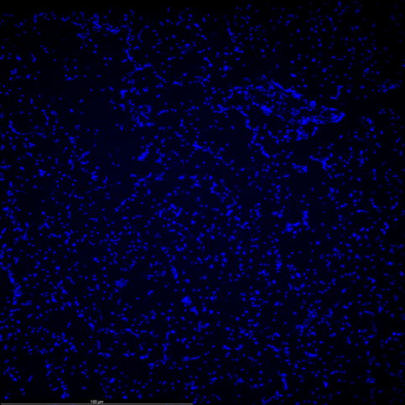
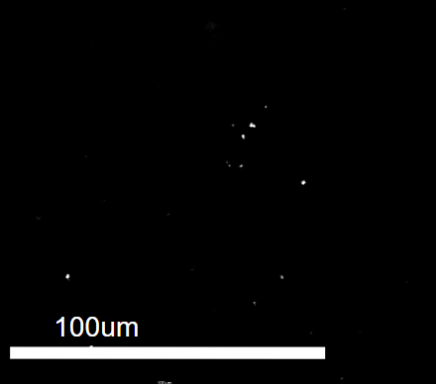
Lab Work: Cell Counts
Cells sampled during time points
Preserved in paraformaldehyde
DAPI staining for counting

Slide 9
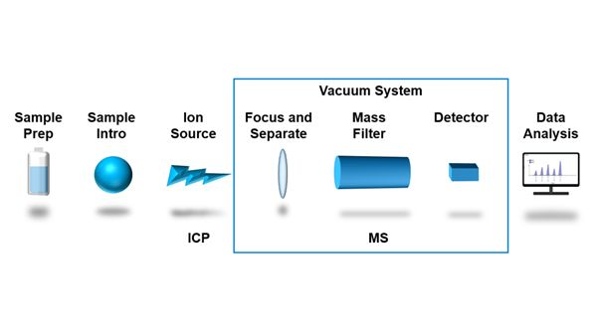
ICP-MS & Other Issues
Growth media must be made with low concentrations of copper/iron
  Helps identify minimum conc. requirements
Too much copper/iron has been in media, using ICP-MS (inductively coupled plasma mass spectrometry) to verify we have the correct concentrations
Filtering media causes issues

Slide 10
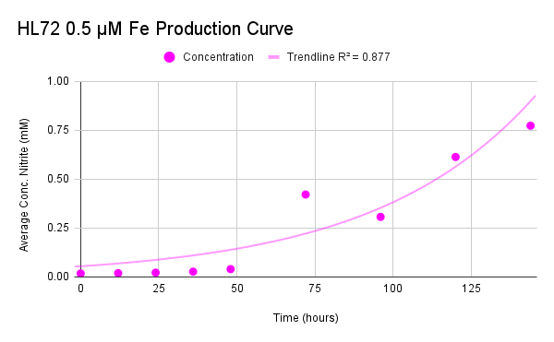
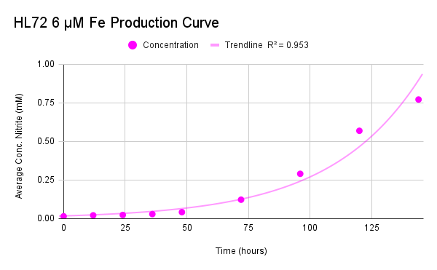
Preliminary Results (Iron)
0.029 mM/hour 0.024 mM/hour
Appears to corroborate speciation results
Copper experiments in progress right now!

Slide 11
Acknowledgements
Thank you to Kate Weeks, Dr. Everett Shock, and other members of the GEOPIG research group for your advice and support on this project as well as ASU Space Grant for funding my research and people like Dr. Tom Sharp and Desiree Crawl for supporting me and other interns throughout the year.

Slide 12
Thank you for your attention!

